Slide 1

THE RESUME PARSER

Slide 2
INTRODUCTION
Technology today has made it possible to send a résumé within the tap of a button.
Hundreds of résumés are being received for a particular job posting. This makes the job of an HR department especially difficult as it is impossible to peruse through each of the résumés and shortlist the candidates.
Moreover, each résumé has a different format. There is a need to extract the relevant information from the resume and store it in the database, so that going through the data becomes easier.
In order to make the job of a recruiter easier, we propose an automated system that does most of the preliminary filtering and presents the data in a standard format.

Slide 3
ABSTRACT
The Resume Parser is to replace slow and expensive human processing of resumes with extremely fast and cost-effective software.
A Resume Parser allows businesses to eliminate the slow and error-prone process of having humans hand-enter resume data into recruitment systems.
A Resume Parser classifies the resume data and outputs it into a format that can then be stored easily and automatically into a database .
By using a Resume Parser, a resume can be stored into the recruitment database in real time, within seconds of when the candidate submitted the resume.

Slide 4
EXISTING SYSTEM
We always and only want the best candidates to be hired.
Hundreds of résumés are being received for a particular job posting. , each résumé has a different format
Going through resume(CV’s) and extracting relevant information from those is one of the most essential task of a manager.
This is extremely difficult job to pursue as it slow , inefficient , more resources and labour required , time taking process.
When a recruiter is looking through hundreds or thousands of them, it can be easy to miss or lose track of potential candidates.
Then why suffer through unproductive labour-intensive manual processes when you can make faster and better hiring decisions?

Slide 5
PROPOSED SYSTEM
The technology is extremely cost-effective and a resource saver and easily accessible.
The applicant screening process is now significantly faster and more efficient and fill positions at a faster rate.
The technology helps prevent qualified candidates from slipping through the cracks.
Automating the recruitment process will lead us to many benefits .
This project automates the bulk resumes and parsers them for us to get the required or specific information

Slide 6
SOFTWARE AND HARDWARE REQUIREMENTS
Hardware:
Processor: Intel®core™ i3-7200u CPU @2.50 Hz
RAM: 8.00GB (3.90 GB usable)
Operating System: Windows 7 or above
Software :
Python - version 3.0 or above
Anaconda or Jupyter Notebook
Python programming
Regular Expression
Python(packages) Spacy Functions

Slide 7
PROCESS FLOW
ACCEPT RESUMES
CONVERT PDF TO TEXT
USING NLP AND REGULAR EXPRESSIONS MATCHING
STORE REQUIRED SECTIONS IN EXCEL SHEET
EXTRACTING INFORMATION AND APPENDING

Slide 8
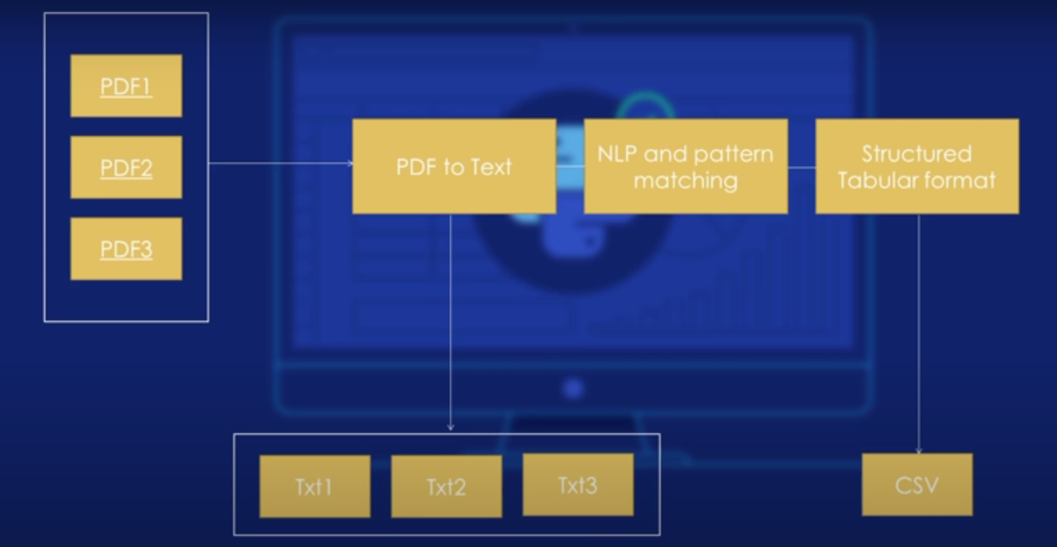
WORKFLOW

Slide 9
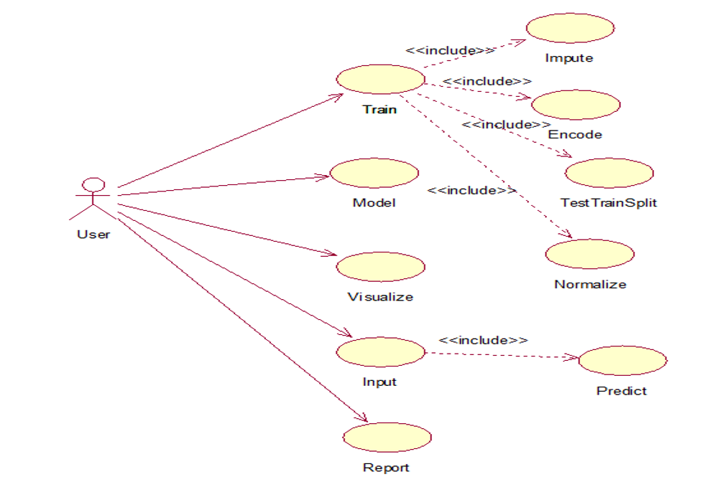
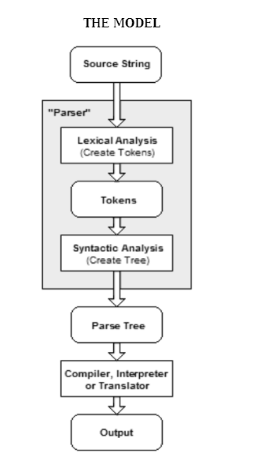

Slide 10

Activity Diagram
Different resume pdfs convert to text
Text matching using Natural language processing and regular expression and appending to result set
Converting into a tabular format csv file

Slide 11
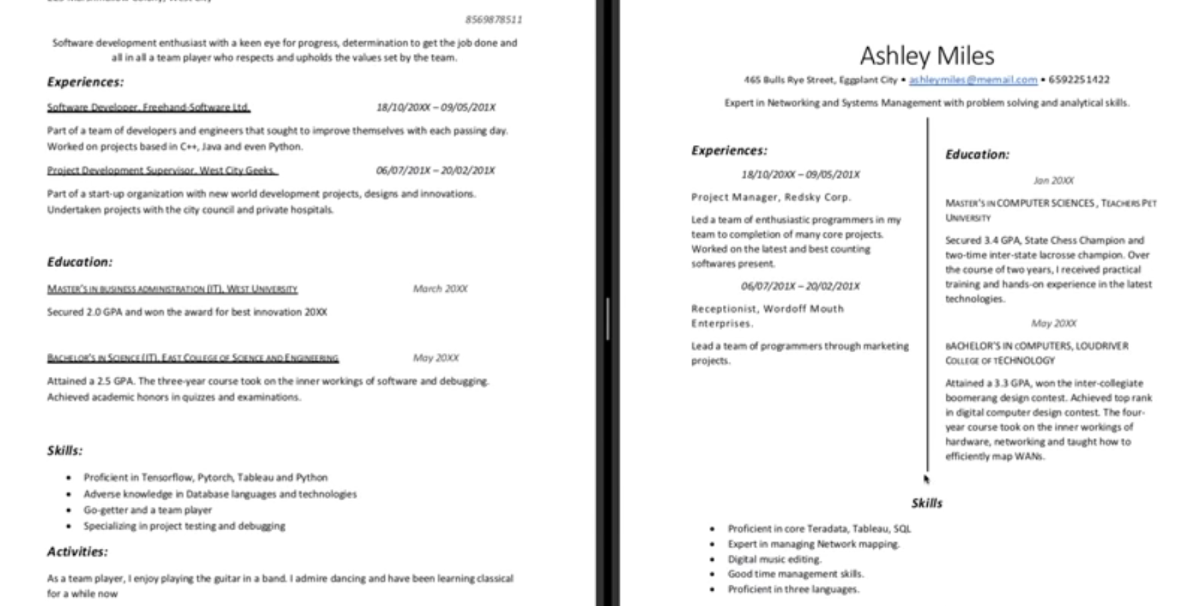

Slide 12
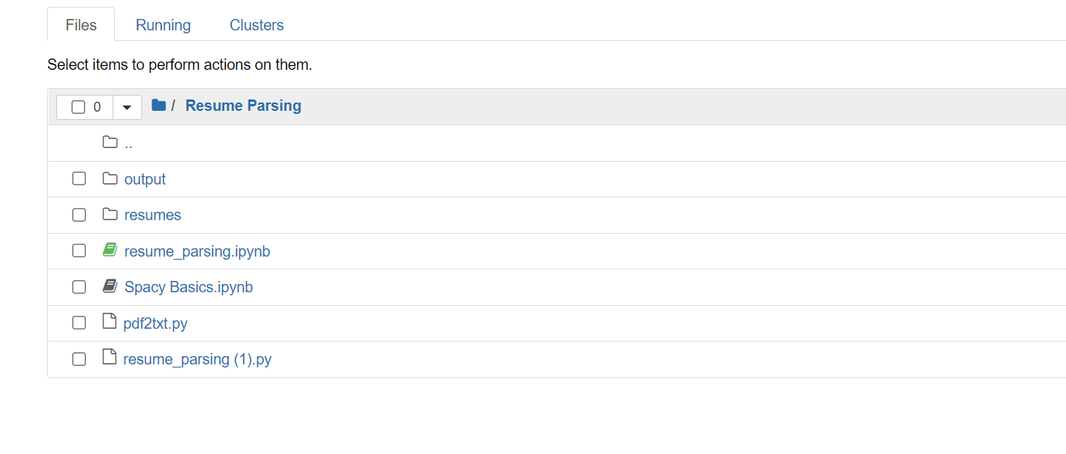
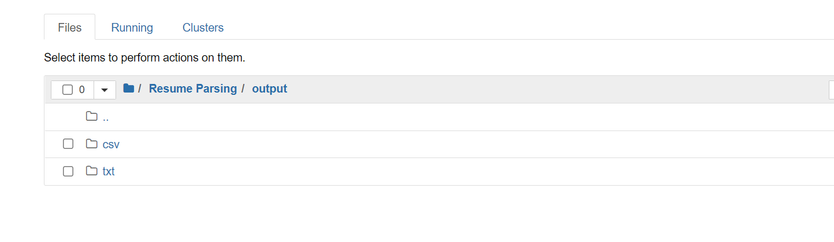

Slide 13
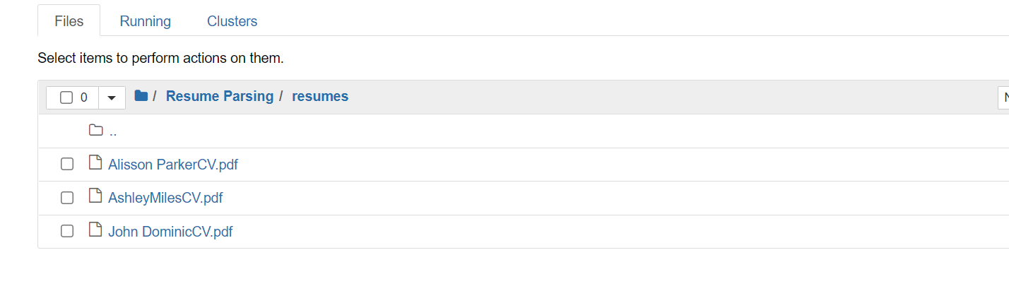
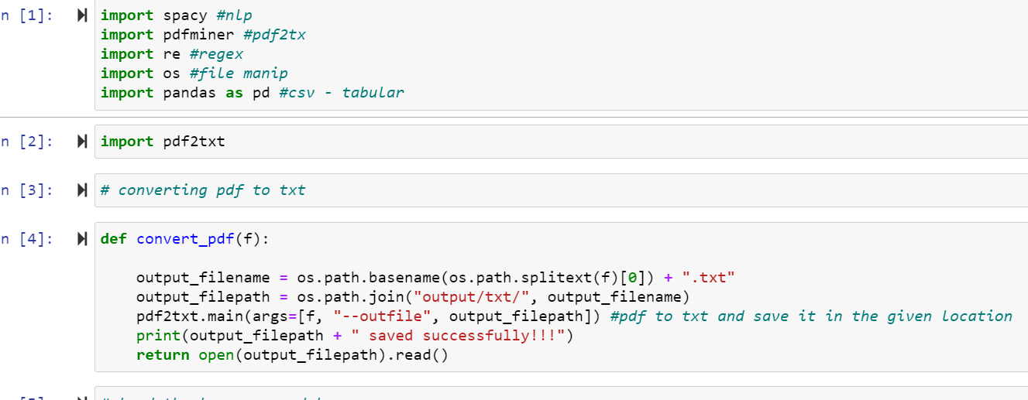

Slide 14
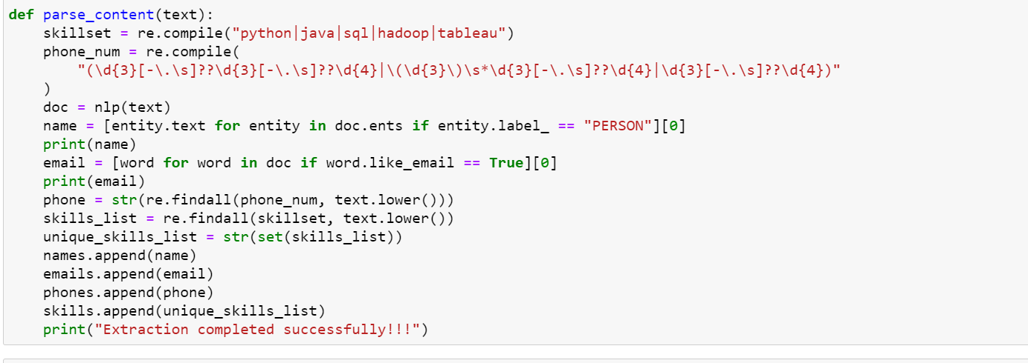
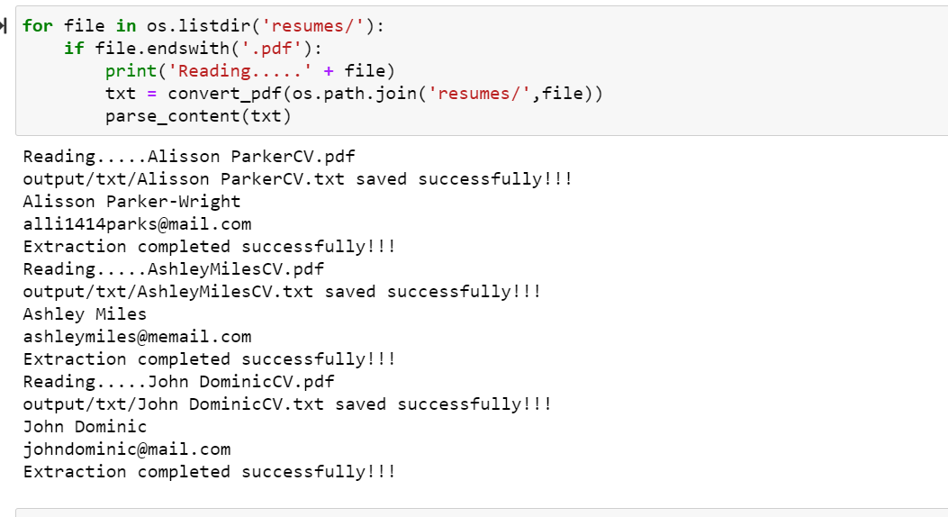

Slide 15
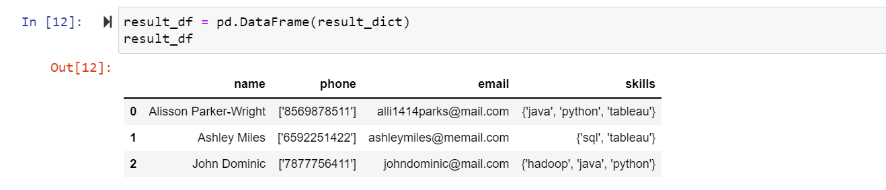
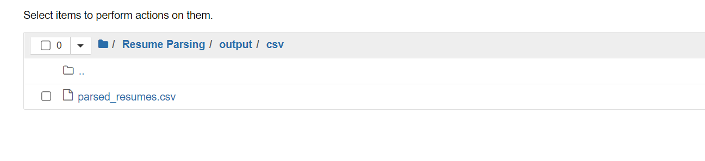
Outputs:

Slide 16
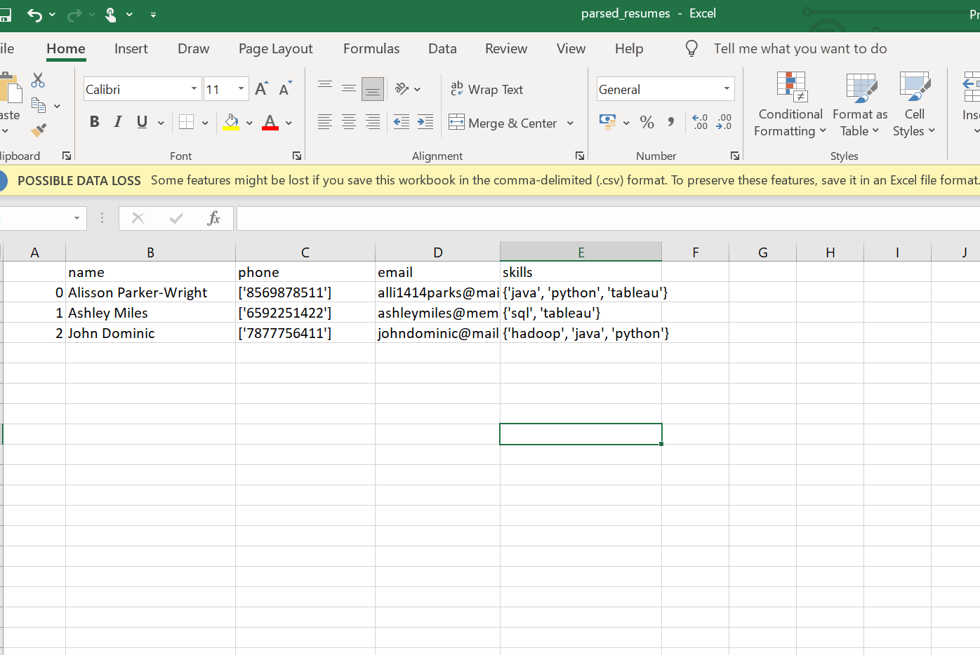
Output File

Slide 17
THE BENEFITS OF USING RESUME PARSER
Benefits for Candidates: When a recruiting site uses a Resume Parser, candidates do not need to fill out applications. They can simply upload their resume and let the Resume Parser enter all the data into the site's CRM and search engines.
Benefits for Recruiters: Because using a Resume Parser eliminates almost all of the candidate's time and hassle of applying for jobs, sites that use Resume Parsing receive more resumes, and more resumes from great-quality candidates and passive job seekers, than sites that do not use Resume Parsing.
Benefits for Executives: Because a Resume Parser will get more and better candidates, and allow recruiters to "find" them within seconds, using Resume Parsing will result in more placements and higher revenue.

Slide 18
APPLICATION OF RESUME PARSER
Any company that wants to compete effectively for candidates, or bring their recruiting software and process into the modern age, needs a Resume Parser.
Corporate jobsites
Job boards
Recruitment software vendors
Recruiting or staffing firms
Executive Placement firms
Outplacement firms
Recruitment Process Outsourcing (RPO) firms

Slide 19
CONCLUSION
Our approach is to make the work of companies and candidates easier and effective. Basically our aim is to ease the recruitment process. The process will provide the quality of applicants for the companies. The unfair and discriminatory practice in the process will be dampened. Based on the information in the form of technical skills the resumes will be ranked in order.

Slide 20
REFERENCE
https://en.wikipedia.org/wiki/R%C3%A9sum%C3%A9_parsing#Software_and_vendors
https://www.g2.com/articles/resume-parsing

Slide 21
Thank you

